Slide 1
An Introduction to Machine Learning
Shiyu Duan
08/27/2019

Slide 2
About me
Shiyu Duan (段施宇), or Michael
🇨🇳
Starting my 3rd year as a PhD student
Research Interests: kernel method for deep learning; machine learning security; computer vision
Contact: michaelshiyu@ufl.edu
Office hour: Wed. 14:00-16:00, NEB 454
Notes:
Why learning from training data works for test data?
Magical number?
Won't show up in hws or projs

Slide 3
Things to cover
Formulate “learning”
Two ways to learn
The bias-complexity tradeoff
VC dimension & Rademacher complexity
Notes:
Survey

Slide 4
Formulate “learning”
What is the “learning” in machine learning?

Slide 5
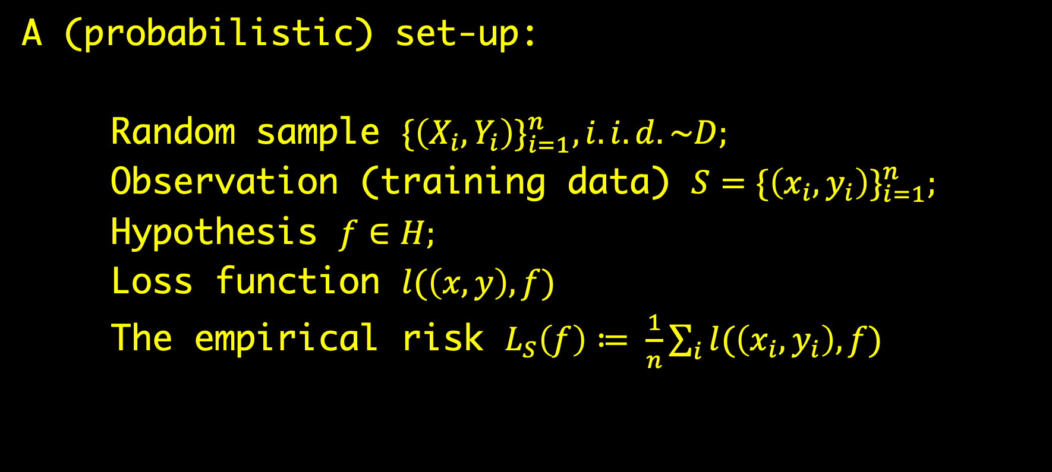
Formulate “learning”
A (probabilistic) set-up:
Random sample ${\{\left(X_{i}, Y_{i}\right)\}}_{i=1}^{n}, i.i.d. \sim D;$
Observation (training data) $S={\{\left(x_{i}, y_{i}\right)\}}_{i=1}^{n};$
Hypothesis $f∈H;$
Loss function $l(\left(x, y\right), f)$
The empirical risk $L_{S}\left(f\right)≔ \frac{1}{n}\sum_{i}{l(\left(x_{i}, y_{i}\right), f)}$
Notes:
Unobserved signal
observed data
example: daily avg temperature in San Francisco

Slide 6
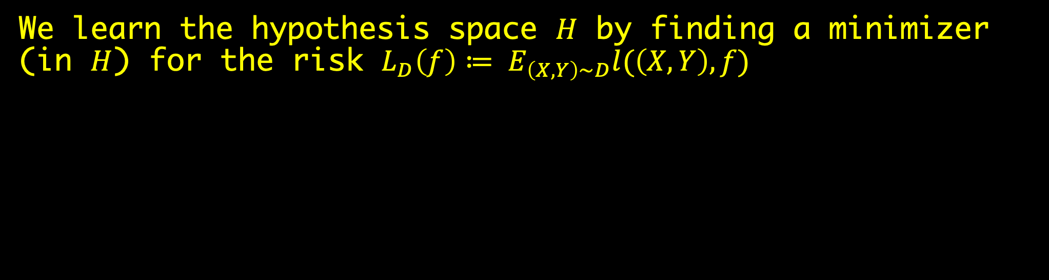
Formulate “learning”
We learn the hypothesis space $H$ by finding a minimizer (in $H$) for the risk ${L_{D}\left(f\right)≔ E}_{\left(X, Y\right)\sim D}l(\left(X, Y\right), f)$

Slide 7
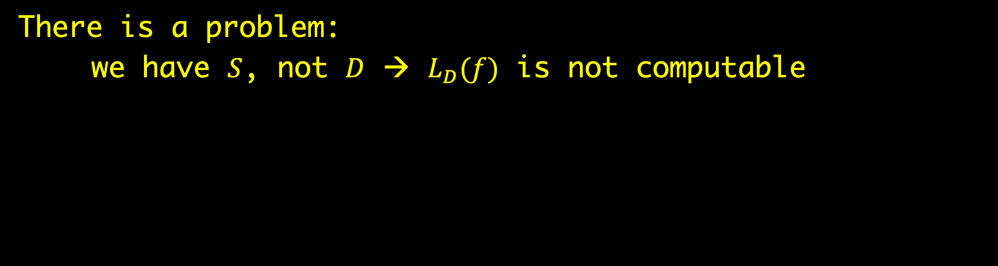
Formulate “learning”
There is a problem:
we have $S$, not $D$ → $L_{D}(f)$ is not computable
Notes:
ML = stats w/o distributional assumptions

Slide 8
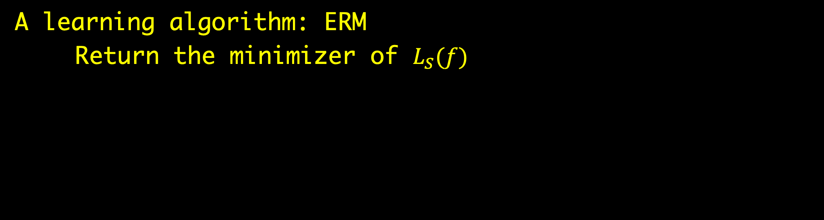
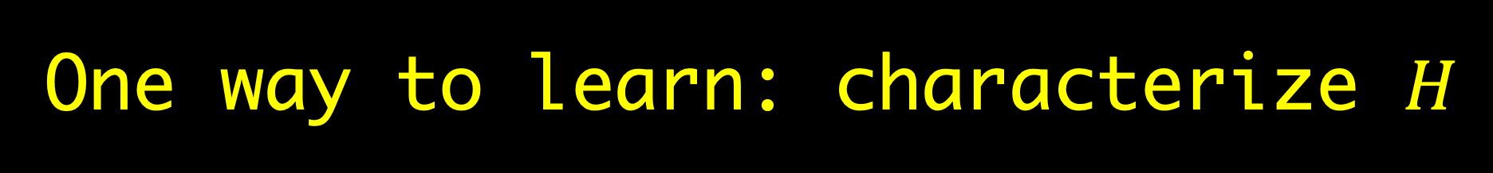
One way to learn: characterize $H$
A learning algorithm: ERM
Return the minimizer of $L_{S}(f)$
Notes:
This naive method might work!
There are Hs for which the minimizer of L_S is close to that of L_D
example: |H|=1
Intuitively, success of ERM also depends on sample size

Slide 9
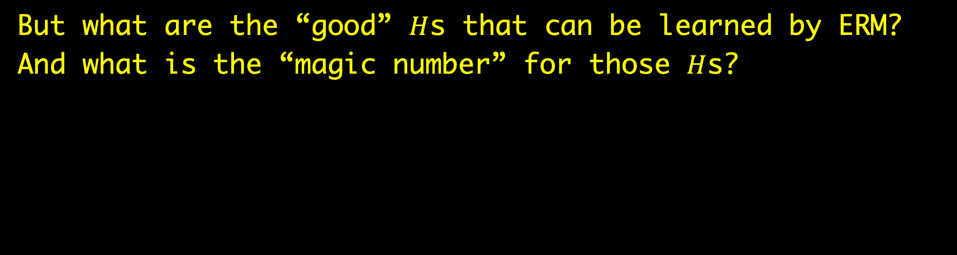
One way to learn: characterize $H$
But what are the “good” $H$s that can be learned by ERM?
And what is the “magic number” for those $H$s?

Slide 10
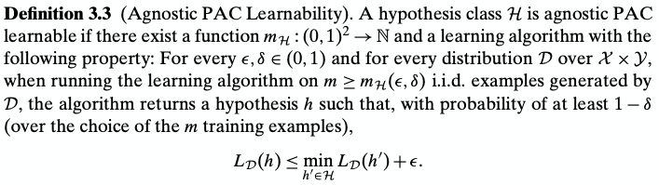
One way to learn: characterize $H$
PAC learnability & sample complexity
Notes:
Method 1: characterize the "good" models
Given an H, there is a magic number m_H, and if you have that many examples, you win
Caveat: nobody said that this magic number is small

Slide 11
One way to learn: characterize $H$
Leslie Valiant (Turing Award 2010 Winner)
Notes:
"In 1983 he published an important paper [4] in the area of semantics for cognitive computation. In it he devised a model of learning that offers a quantitative criterion on when a computing device can be considered to be able to learn. This probably approximately correct (PAC) model has given rise to a fruitful research area now known as computational learning theory. The PAC model considers a learning algorithm that takes experience from the past to create a hypothesis that can be used to make a decision in the future with controlled error. The model has been intensively studied and extended by other researchers into an important tool in practical applications.”
Source: https://amturing.acm.org/award_winners/valiant_2612174.cfm

Slide 12
One way to learn: characterize $H$
Many “good” hypothesis spaces are (agnostic) PAC learnable by ERM

Slide 13
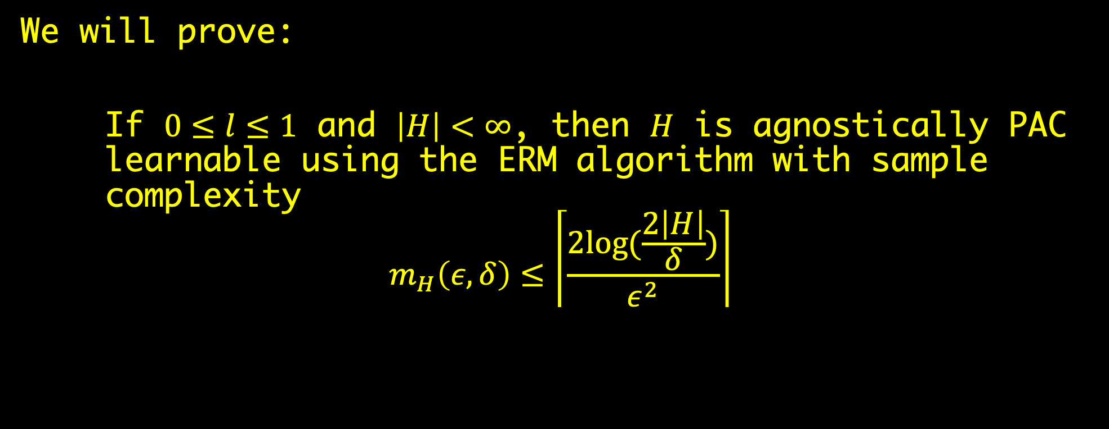
Example: finite classes are (agnostic) PAC learnable by ERM
We will prove:
If $0≤l≤1$ and $\left|H\right|<∞$, then $H$ is agnostically PAC learnable using the ERM algorithm with sample complexity
$$m_{H}\left(ε, δ\right)≤\left\lceil \frac{2log⁡(\frac{2\left|H\right|}{δ})}{ε^{2}}\right\rceil$$
Notes:
The discretization trick

Slide 14
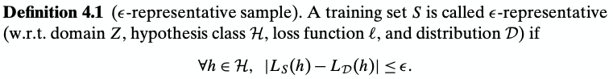
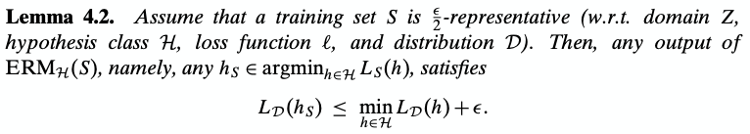
Example: finite classes are (agnostic) PAC learnable by ERM
Notes:
Z is where (X, Y) is defined

Slide 15
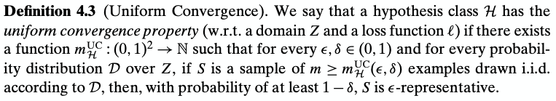
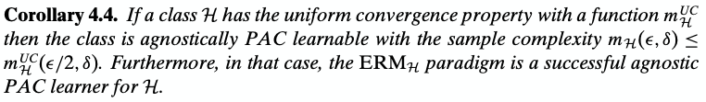
Example: finite classes are (agnostic) PAC learnable by ERM

Slide 16
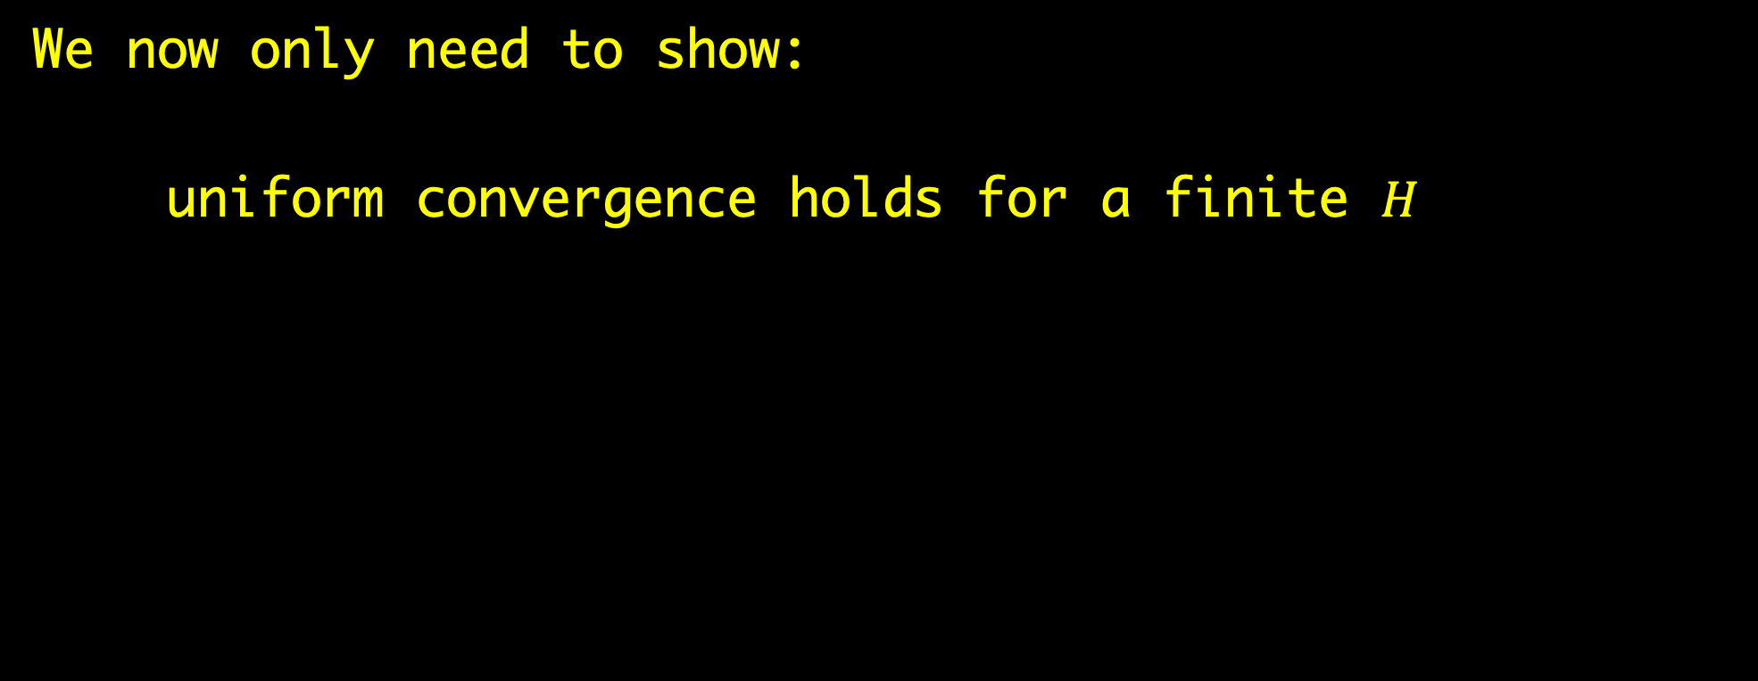
Example: finite classes are (agnostic) PAC learnable by ERM
We now only need to show:
uniform convergence holds for a finite $H$

Slide 17
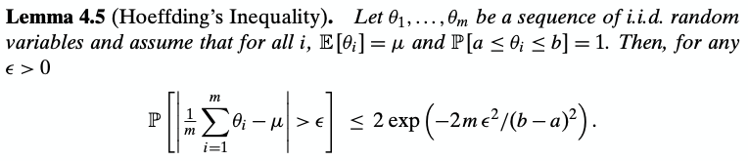
Example: finite classes are (agnostic) PAC learnable by ERM
Notes:
Concentration inequalities

Slide 18
One way to learn: characterize $H$
What are some other “good” hypothesis spaces?

Slide 19
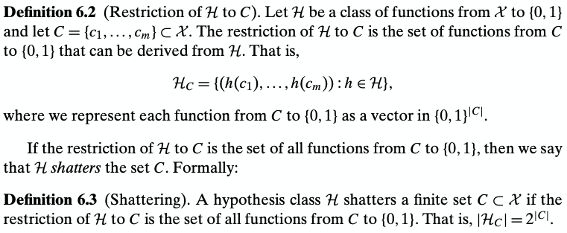
One way to learn: characterize $H$
The VC dimension

Slide 20
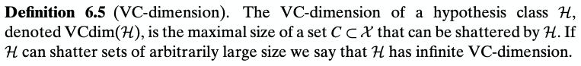
One way to learn: characterize $H$
The VC dimension
Notes:
An easier-to-understand def:
VC dim is d iff
there is a set of d points on which any labeling can be realized by some f in H
and there exists no set of d+1 points …

Slide 21
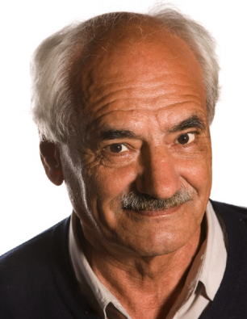
One way to learn: characterize $H$
Alexey Yakovlevich Chervonenkis (1938 – 2014)

Slide 22
One way to learn: characterize $H$
Vladimir Vapnik (left) and some random dude
Notes:
We are delighted to announce that Vladimir Vapnik has joined Facebook AI Research. Vladimir is universally known in the machine learning and statistics communities as the father of statistical learning theory and the co-inventor of the Support Vector Machine method. One of the key concepts of learning theory bears his name: the Vapnik-Chervonenkis Dimension, which measures the capacity of a learning machine. Vladimir is rejoining some of his long-time collaborators Jason Weston, Ronan Collobert, and Yann LeCun. He is working on new book, and will be collaborating with FAIR research scientists to develop some of his new ideas on conditional density estimation, learning with privileged information, and other topics.
Source: https://www.facebook.com/FacebookAI/photos/a.360372474139712/372090452967914/?type=3&theater
“Convolutional Nets and SVMs were developed within a few years of each other (between 1988 and 1992) in the Adaptive Systems Research Department at Bell Labs in Holmdel, NJ. Larry Jackel was the head of the department whose research staff included Vladmir Vapnik and me, along with Bernhardt Boser, Léon Bottou, John Denker, Hans-Peter Graf, Isabelle Guyon, Patrice Simard, and Sara Solla.
In 1995, Vladimir Vapnik and Larry Jackel made two bets (I was the witness, though admittedly not and entirely impartial one). In the first bet, Larry claimed that by 2000 we will have a theoretical understanding of why big neural nets work well (in the form of a bound similar to what we have for SVMs). He lost.
In the second bet, Vladimir Vapnik claimed that by 2000 no one in their right mind would use neural nets of the type we had in 1995 (he claimed that everyone would be using SVM). Not only Vladimir lost that one in 2000, but recent deployments of neural nets by Google and Microsoft are proving him wrong in 2012"
— Yann Le Cun
Source: https://medium.com/bcggamma/7-stories-behind-the-worlds-most-popular-machine-learning-algorithms-51472939d14b

Slide 23
One way to learn: characterize $H$
The 1995 bet
Notes:
Source: https://syncedreview.com/2017/02/21/nvidia-end-to-end-self-driving/
“Convolutional Nets and SVMs were developed within a few years of each other (between 1988 and 1992) in the Adaptive Systems Research Department at Bell Labs in Holmdel, NJ. Larry Jackel was the head of the department whose research staff included Vladmir Vapnik and me, along with Bernhardt Boser, Léon Bottou, John Denker, Hans-Peter Graf, Isabelle Guyon, Patrice Simard, and Sara Solla.
In 1995, Vladimir Vapnik and Larry Jackel made two bets (I was the witness, though admittedly not and entirely impartial one). In the first bet, Larry claimed that by 2000 we will have a theoretical understanding of why big neural nets work well (in the form of a bound similar to what we have for SVMs). He lost.
In the second bet, Vladimir Vapnik claimed that by 2000 no one in their right mind would use neural nets of the type we had in 1995 (he claimed that everyone would be using SVM). Not only Vladimir lost that one in 2000, but recent deployments of neural nets by Google and Microsoft are proving him wrong in 2012"
— Yann Le Cun
Source: https://medium.com/bcggamma/7-stories-behind-the-worlds-most-popular-machine-learning-algorithms-51472939d14b

Slide 24
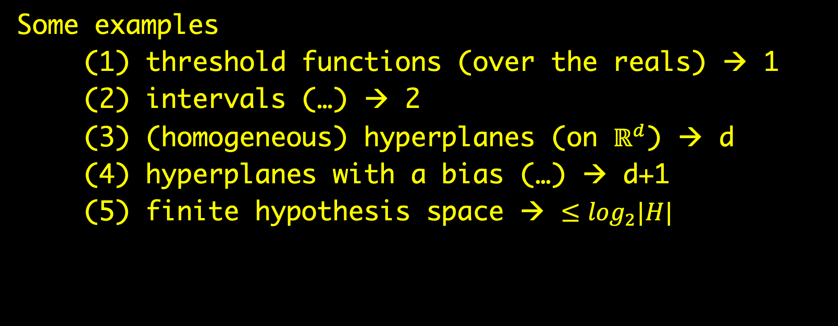
One way to learn: characterize $H$
Some examples
(1) threshold functions (over the reals) → 1
(2) intervals (…) → 2
(3) (homogeneous) hyperplanes (on $ℝ^{d}$) → d
(4) hyperplanes with a bias (…) → d+1
(5) finite hypothesis space → $≤\log_{2}|H|$

Slide 25
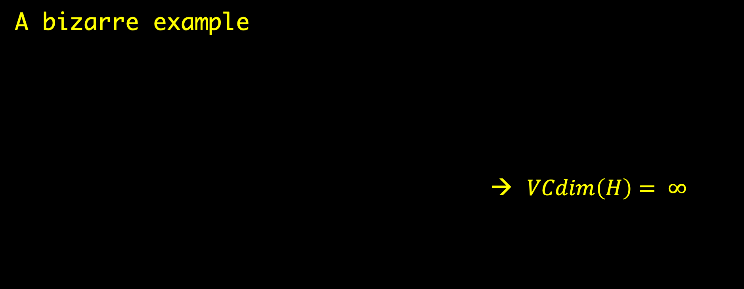
One way to learn: characterize $H$
A bizarre example
→ $VCdim\left(H\right)= ∞$
Notes:
# of param is not necessarily related to VC dim

Slide 26
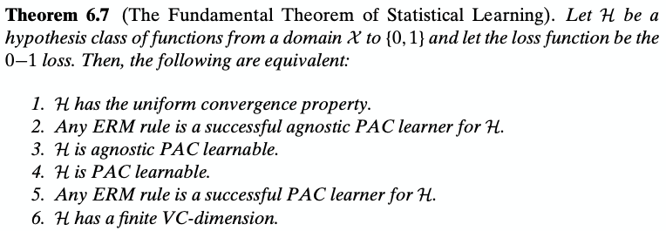
One way to learn: characterize $H$

Slide 27
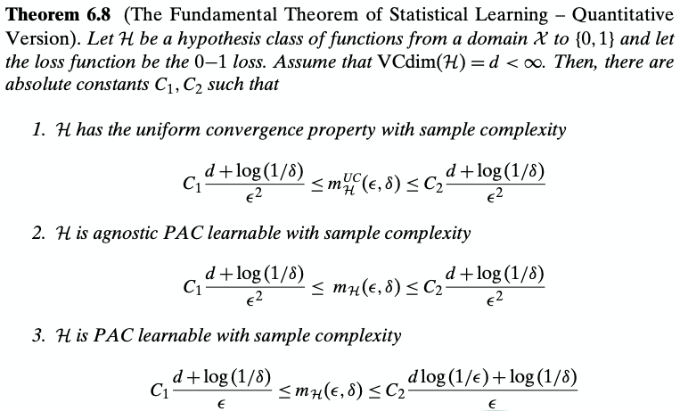
One way to learn: characterize $H$
Notes:
“…A similar result holds for some other learning problems such as regression with the absolute loss or the squared loss.
However, the theorem does not hold for all learning tasks. In particular, learnability is sometimes possible even though the uniform convergence property does not hold (we will see an example in Chapter 13, Exercise 6.2).
Furthermore, in some situations, the ERM rule fails but learnability is possible with other learning rules."

Slide 28
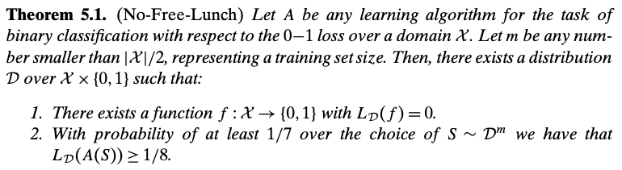
A digression: the No-Free-Lunch Theorem

Slide 29

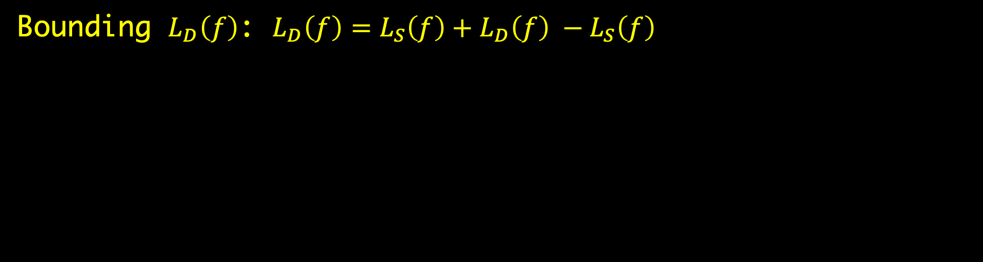
Another way: bound $L_{D}(f)$
Bounding $L_{D}\left(f\right)$: $L_{D}\left(f\right)=L_{S}\left(f\right)+L_{D}\left(f\right) −L_{S}\left(f\right)$
Notes:
If we have this, then the rest is an optimization problem
Need to min two terms simultaneously and the two terms often contradict each other --> a version of the bias-complexity tradeoff
We essentially need to bound

Slide 30
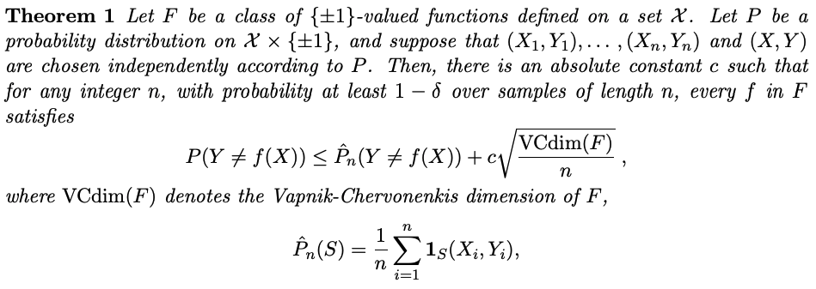
Another way: bound $L_{D}(f)$
Example: bound in terms of VC dimension
Notes:
More informative than the bounds we've seen because it tells you what happens for n smaller than the "magic number"
Essentially we now only need to bound the VC dim of F
Source: Bartlett, P. L., & Mendelson, S. (2002). Rademacher and Gaussian complexities: Risk bounds and structural results. Journal of Machine Learning Research, 3(Nov), 463-482.

Slide 31
Another way: bound $L_{D}(f)$
Although, bounds on VC dimension are usually difficult to obtain

Slide 32
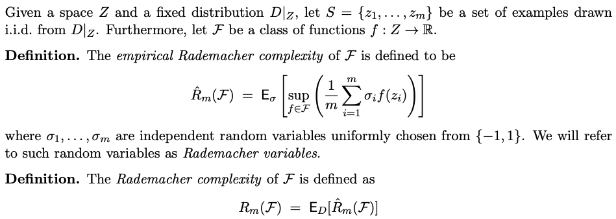
Another way: bound $L_{D}(f)$
An easier-to-work-with alternative to VC dimension
Notes:
Source: http://www.cs.cmu.edu/~ninamf/ML11/lect1117.pdf
Intuitively, this measures...almost correlation...
Gaussian complexity…can be shown that G and R complexities bound each other

Slide 33
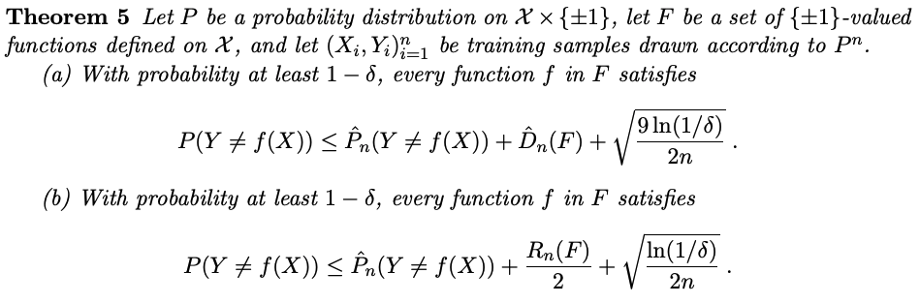
Another way: bound $L_{D}(f)$
Example risk bounds in terms of the R complexity
Notes:
So it boils down to bounding R_n(F)

Slide 34

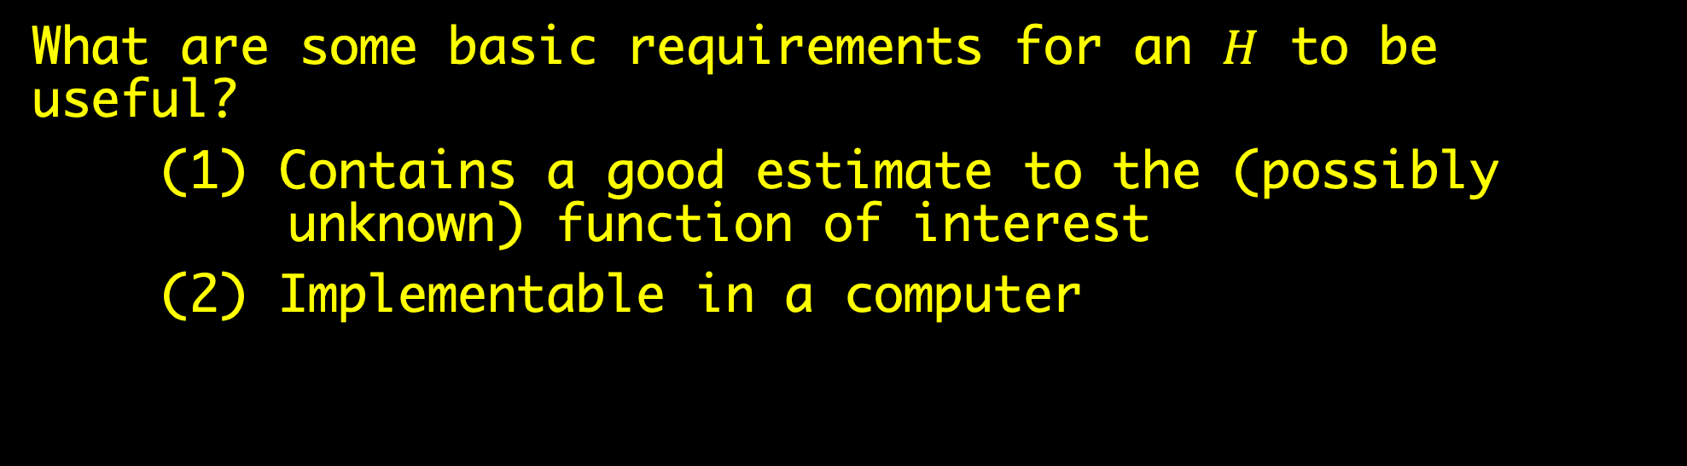
Example: R complexity of some $H$s
What are some basic requirements for an $H$ to be useful?
(1) Contains a good estimate to the (possibly unknown) function of interest
(2) Implementable in a computer
Notes:
Previously we have taken H as some generic hypothesis space
We now give two concrete examples: a two-layer MLP & a kernel machine
(1)…function of interest. For example, image classification can be modeled by a function…

Slide 35
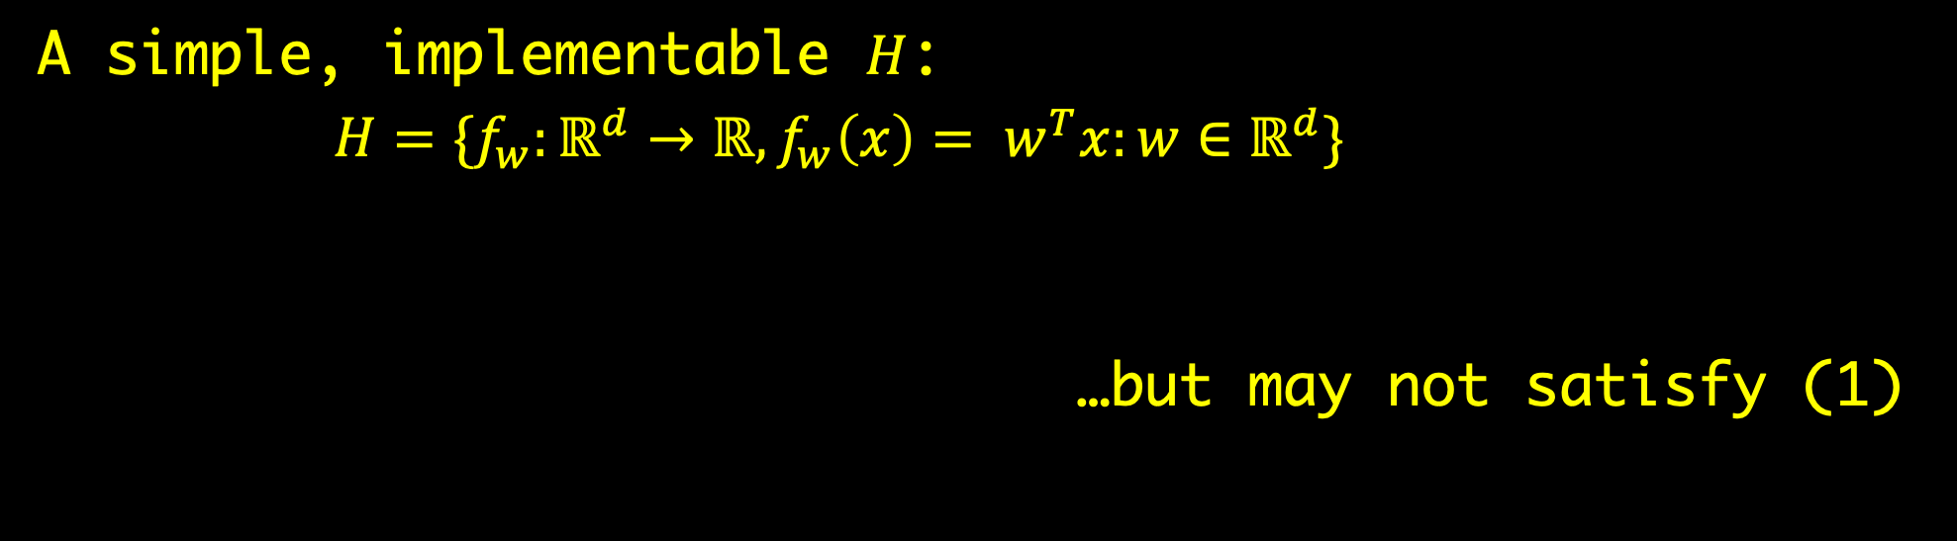
Example: R complexity of some $H$s
A simple, implementable $H$:
$H=\{f_{w}:{ℝ^{d}→ℝ, f}_{w}\left(x\right)= w^{T}x:w∈ℝ^{d}\}$
…but may not satisfy (1)
Notes:
Can be extended in two directions

Slide 36
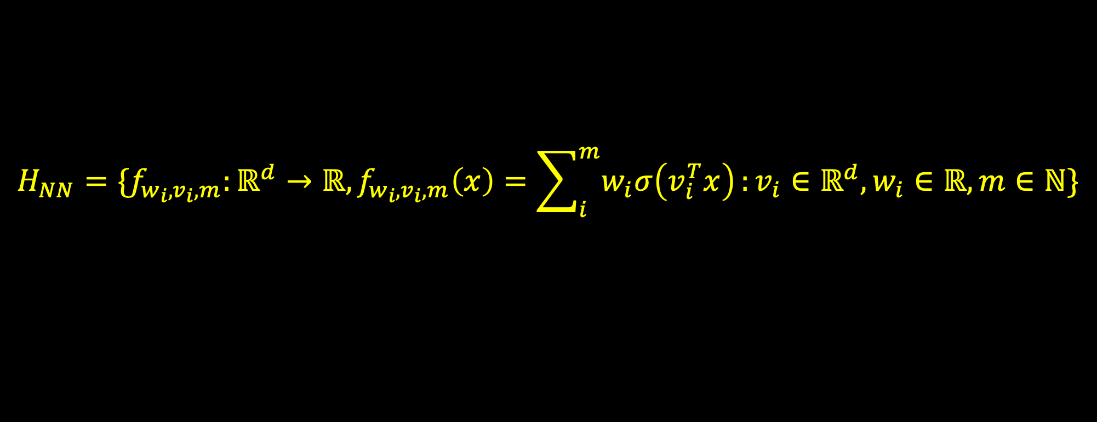
Example: R complexity of some $H$s
A two-layer MLP is a hypothesis space defined by…
$$H_{NN}=\{f_{w_{i}, v_{i},m}:{ℝ^{d}→ℝ, f}_{w_{i}, v_{i},m}\left(x\right)=\sum_{i}^{m}{w_{i}σ\left(v_{i}^{T}x\right)}:v_{i}∈ℝ^{d}, w_{i}∈ℝ,m∈ℕ\}$$
Notes:
Sigma is…
Draw a picture: build the model by connecting hyperplanes (neurons) → connectionism

Slide 37
Example: R complexity of some $H$s
A two-layer MLP is a hypothesis space defined by…
…it is a universal function approximator (under some conditions)
$$H_{NN}=\{f_{w_{i}, v_{i},m}:{ℝ^{d}→ℝ, f}_{w_{i}, v_{i},m}\left(x\right)=\sum_{i}^{m}{w_{i}σ\left(v_{i}^{T}x\right)}:v_{i}∈ℝ^{d}, w_{i}∈ℝ,m∈ℕ\}$$
Notes:
…under conditions on m and sigma. Without sigma, the model loses its magic as a universal estimator

Slide 38
Example: R complexity of some $H$s
Consider: a hyperplane has limited expressive power since it cannot classify non-linearly-separable data.
Notes:
…but what if we change its perspective?
Example: ...

Slide 39
Example: R complexity of some $H$s
A kernel machine is a hypothesis space defined by…
$$H_{KM}=\{f_{w}:{ℝ^{d}→ℝ, f}_{w}\left(x\right)= w^{T}φ(x):w∈ℝ^{p}\}$$
Notes:
Phi changes the perspective

Slide 40
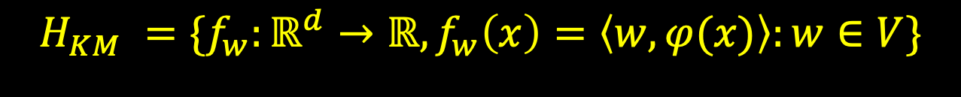
Example: R complexity of some $H$s
A kernel machine is a hypothesis space defined by…
…it is a universal function approximator (under some conditions)
$$H_{KM} =\{f_{w}:{ℝ^{d}→ℝ, f}_{w}\left(x\right)=\left\langle w, φ(x)\right\rangle :w∈V\}$$
Notes:
More generally, …
V can be any inner prod space
Inner prod: generalization of dot product to vector spaces other than the Euclidean space
…under some conditions. These conditions usually makes phi highly nontrivial.
For example, phi may map x to an inf seq, in which case we can consider V to be an inf-dimensional space

Slide 41
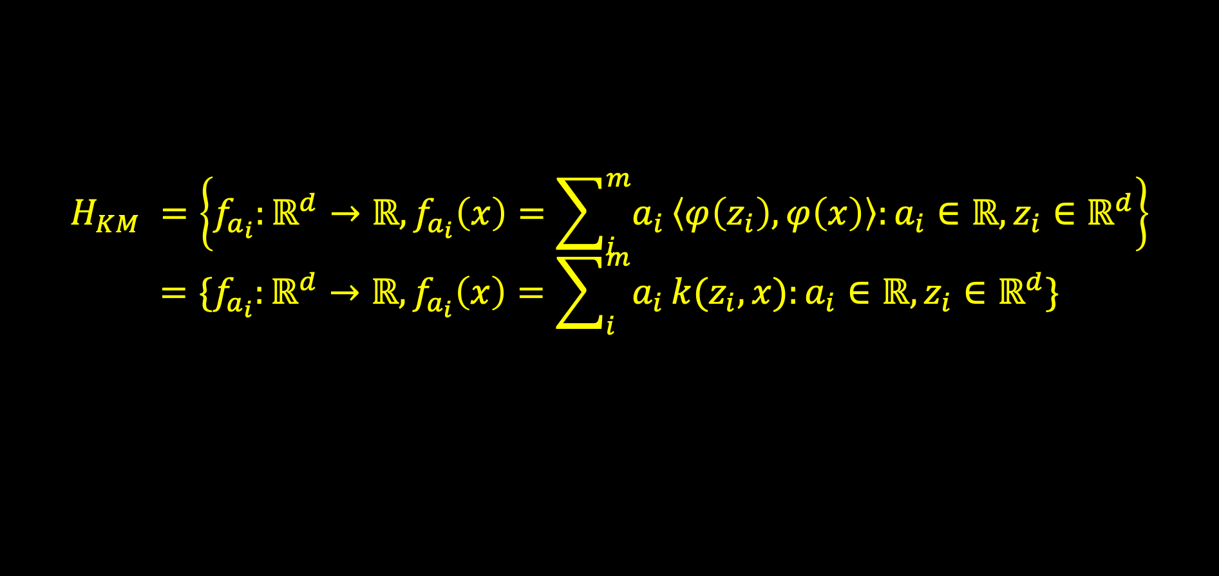
Example: R complexity of some $H$s
A kernel machine is a hypothesis space defined by…
$$H_{KM} =\left\{f_{a_{i}}:{ℝ^{d}→ℝ, f}_{a_{i}}\left(x\right)=\sum_{i}^{m}{a_{i}}\left\langle φ\left(z_{i}\right), φ\left(x\right)\right\rangle :a_{i}∈ℝ, z_{i}∈ℝ^{d}\right\}$$
$$=\{f_{a_{i}}:{ℝ^{d}→ℝ, f}_{a_{i}}\left(x\right)=\sum_{i}^{m}{a_{i}}k(z_{i}, x):a_{i}∈ℝ, z_{i}∈ℝ^{d}\}$$
Notes:
To make H implementable again, we use the kernel trick:
there happens to be families of phis w/ <phi(x), phi(y)> = k(x, y) for some k that is implementable
…this approximates the “true” kernel machine. Why?
...and the goodness of the approximation is governed by m and z_i.
Although, the representer theorem states…

Slide 42
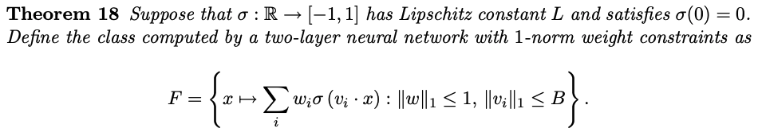
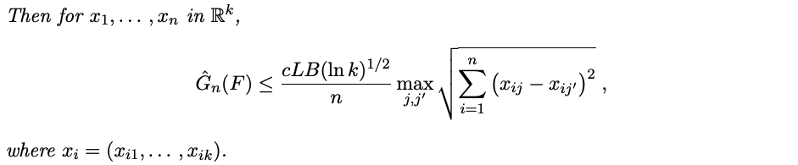
Example: R complexity of a two-layer MLP
We will prove:
Notes:
Lipschitz continuity

Slide 43
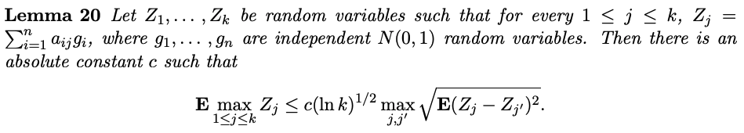
Example: R complexity of a two-layer MLP
We need Slepian’s lemma:

Slide 44
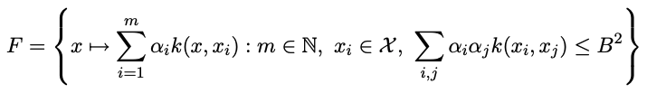
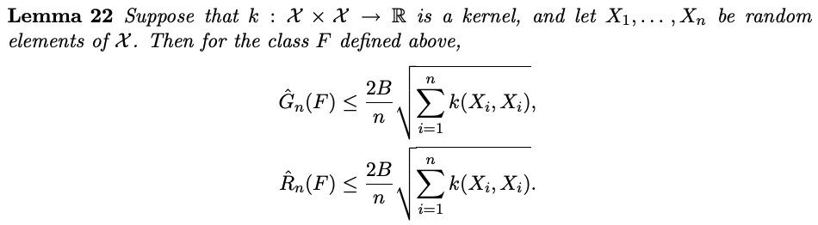
Example: R complexity of a kernel machine
We will prove:

